Slide 1

Flight Leaseback Pro
Aircraft Leaseback Management Software
Built specifically for Flight Schools
By Mauli Systems, Inc.
By Kashyap Shukla
Principal Consultant, OCP
Mauli Systems, Inc.
www.mauli.com

Slide 2
Business Problem Statement
Most flight schools lease their aircraft from individual or institutional investors (lessors). As part of these leasing arrangements, flight schools are required to provide comprehensive monthly reports to lessors, including flight activity, operating expenses, management fees, taxes, net revenue, aircraft utilization, and other key financial and operational metrics.
Today, this reporting process is largely manual. Data is extracted from multiple operational and financial systems, then consolidated and reconciled using spreadsheets such as Microsoft Excel. This fragmented approach consumes significant time and resources, increases the risk of human error, and often results in inconsistent or delayed reporting.

Slide 3
Business Problem Statement
The lack of an automated reporting solution not only impacts operational efficiency but also limits transparency for lessors, delays decision-making, and increases administrative costs. As flight schools grow their fleets and investor base, the manual reporting process becomes increasingly difficult to scale.
This approach presents several challenges:
  Manual data collection and consolidation consume significant staff time.
  Spreadsheet-based reporting is prone to human error and inconsistencies.
  Report generation is slow, delaying the delivery of critical financial information to lessors.
  Limited automation reduces transparency and makes auditing and reconciliation more difficult.
  The overall reporting process increases operational costs and limits scalability as the fleet and investor base grow.

Slide 4
Business Problem Statement
There is a clear need for an automated reporting solution that integrates data from multiple source systems, standardizes report generation, and delivers accurate, timely, and transparent reports to aircraft lessors. Such a solution would reduce administrative effort, improve data accuracy, enhance investor confidence, and enable flight schools to focus on their core business operations.
Flight Leaseback Pro solution is an integrated reporting platform that unifies data from multiple source systems, validates information, and generates standardized monthly reports would significantly reduce manual effort, improve accuracy, enhance transparency, and deliver timely insights for both flight schools and aircraft lessors.

Slide 5
The Difference
Traditional Process | Flight Leaseback Pro
Compile Data in Excel Manually | Automated workflows to upload and validate the datasets
Manual process – error prone – no validation | Secure cloud platform
Time Consuming | Real-time reporting
Missed deadlines | Auto generate reports and emails
Raises more questions by investor, when not enough details are provided | With Net Sheet in the marketing report, which provides details from the beginning of leaseback, every month. Which reduces inquiries.
Notes:
So there is no single solution….

Slide 6
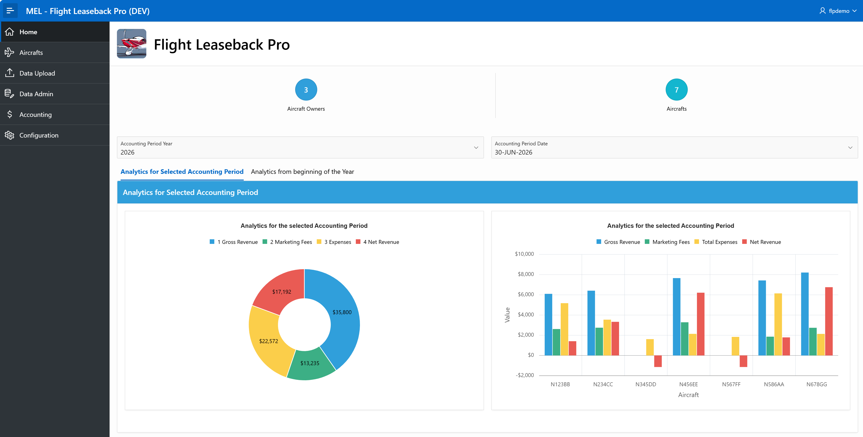
Flight Leaseback Pro - Dashboard
Note: Accounting information is only available to the user who has been granted accounting role.
Notes:
So there is no single solution….

Slide 7
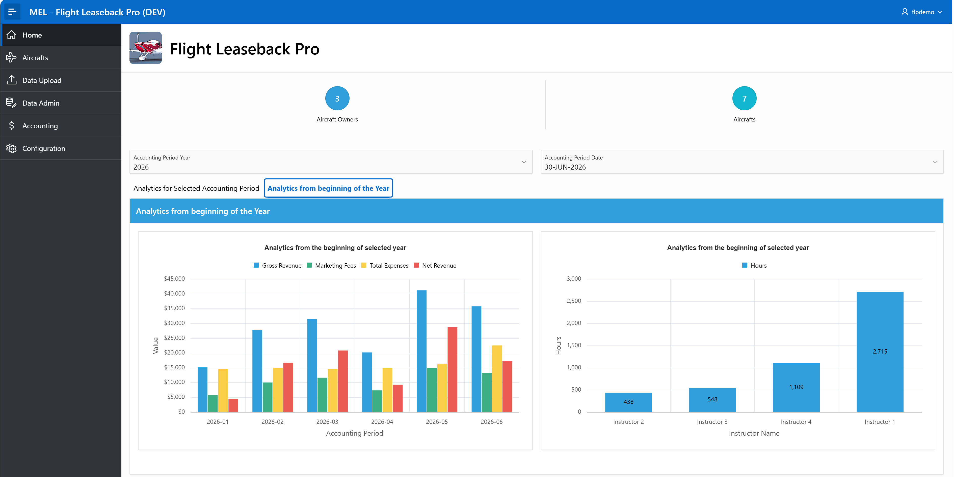
Flight Leaseback Pro - Dashboard
Note: Accounting information is only available to the user who has been granted accounting role.
Notes:
So there is no single solution….

Slide 8
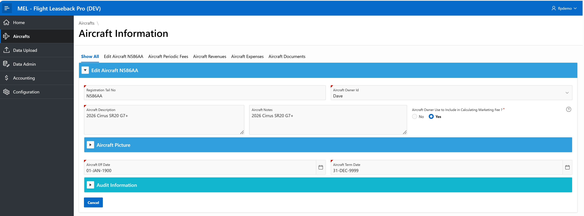
Flight Leaseback Pro – Aircraft Detail
Note:
Drill-down display an aircraft related information and allows to edit if you have proper permissions. Tabs are collapsable and expandable.
Notes:
So there is no single solution….

Slide 9
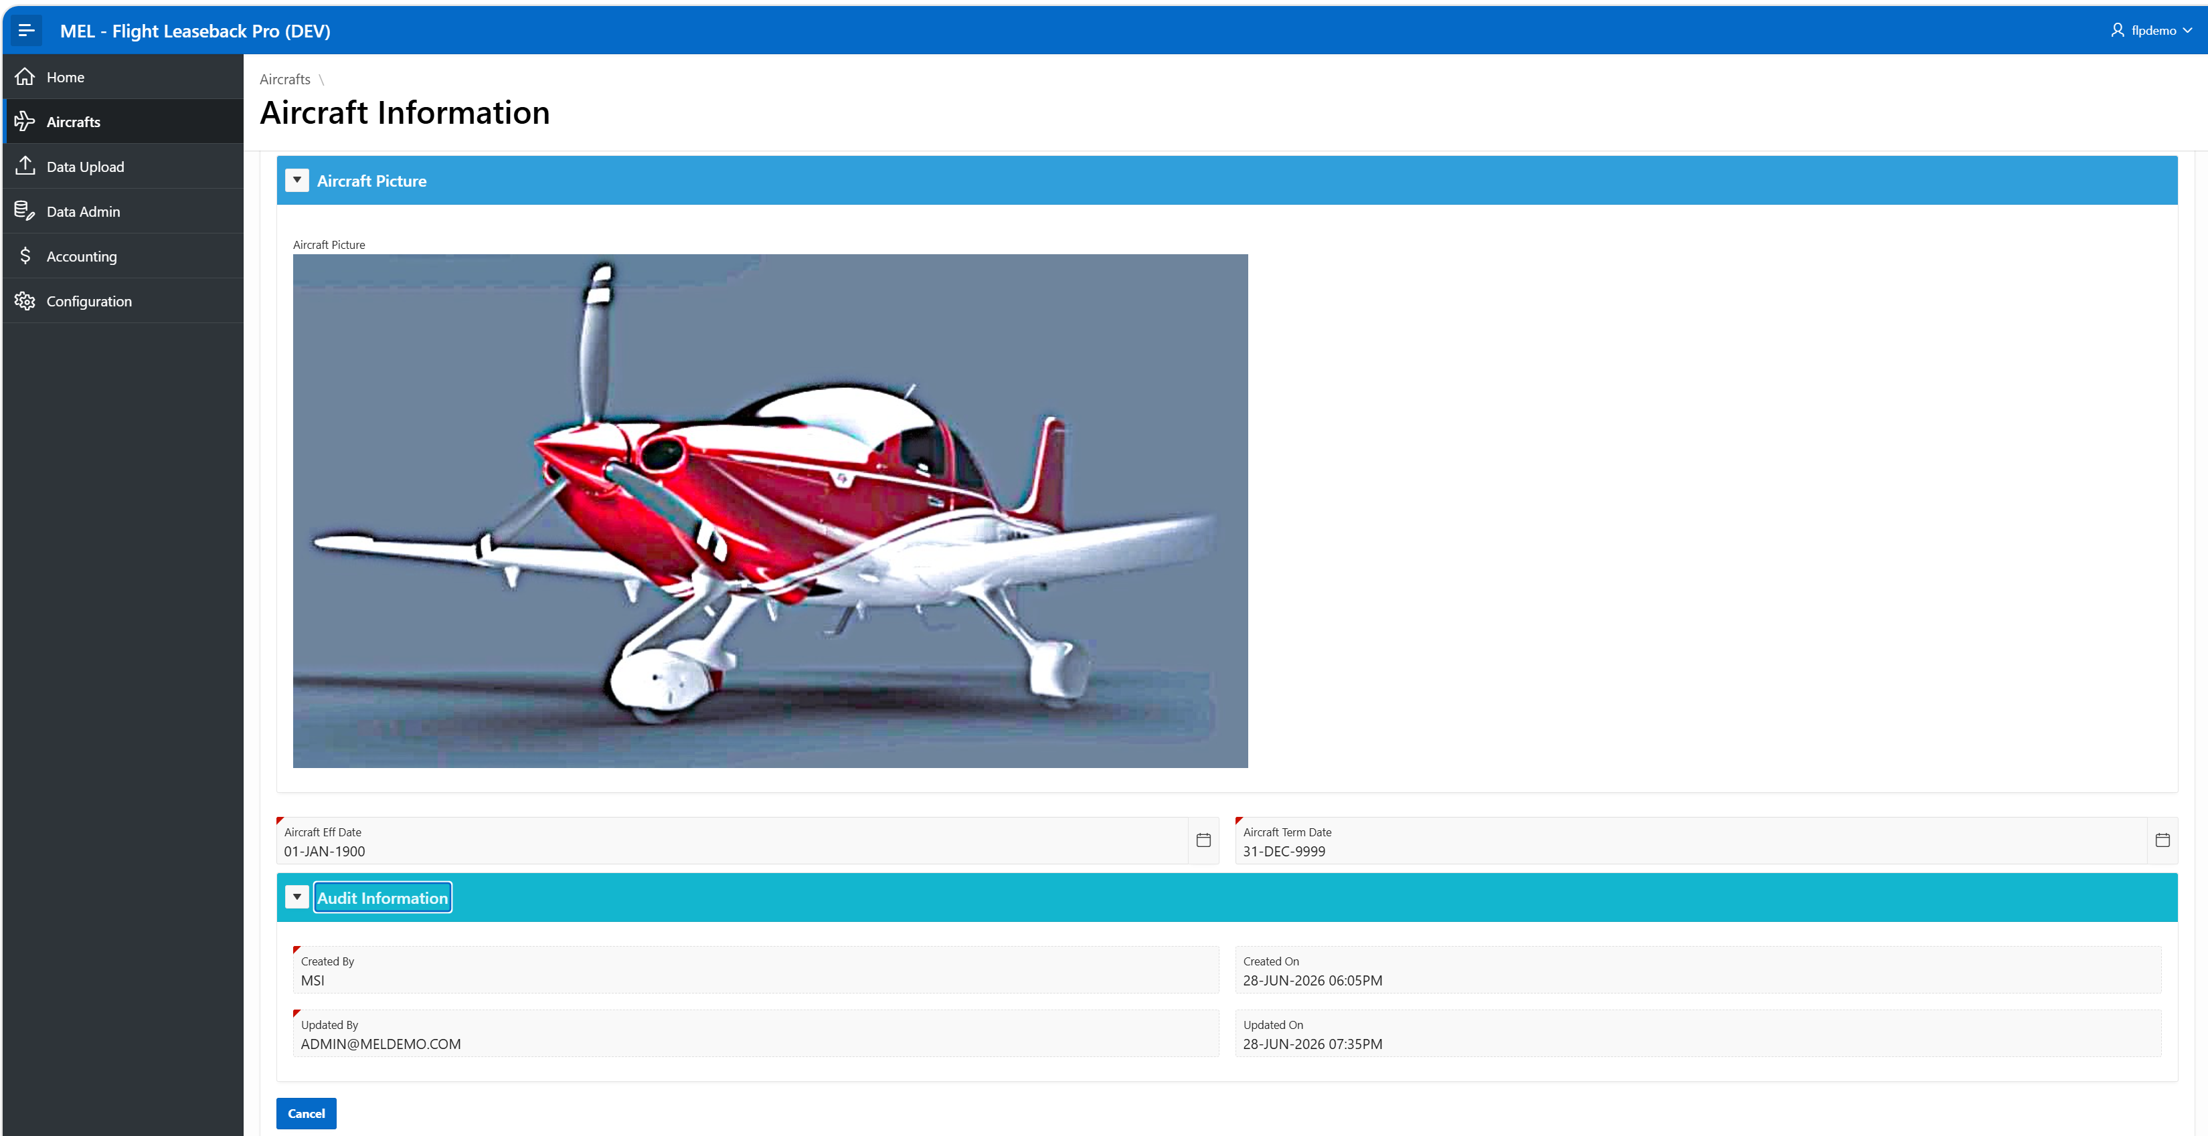
Flight Leaseback Pro – Aircraft Detail
Note:
Allows you to upload aircraft picture.
Also, each dataset maintains audit information .
Notes:
So there is no single solution….

Slide 10
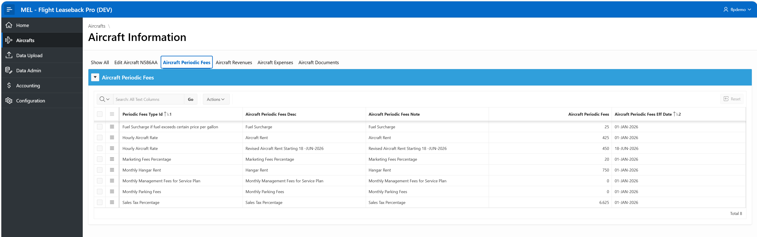
Flight Leaseback Pro - Aircraft Detail
Note: Need to configure aircraft periodic fees, such as rent, hangar/tiedown rent, fuel surcharge (if any applies for specific timeframe), Marketing fee and sales tax %.
These are periodic fees, which can change within the accounting period, where you just need to enter another entry with new effective date.
Notes:
So there is no single solution….

Slide 11
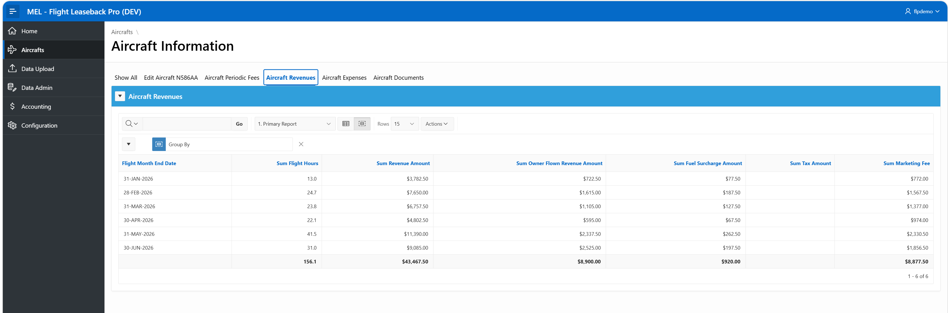
Flight Leaseback Pro - Aircraft Detail
Note: Aircraft Revenues Tab displays summary of accounting numbers per month as a primary report. All such interactive reports can be customized and saved for future use by end user.
Notes:
So there is no single solution….

Slide 12
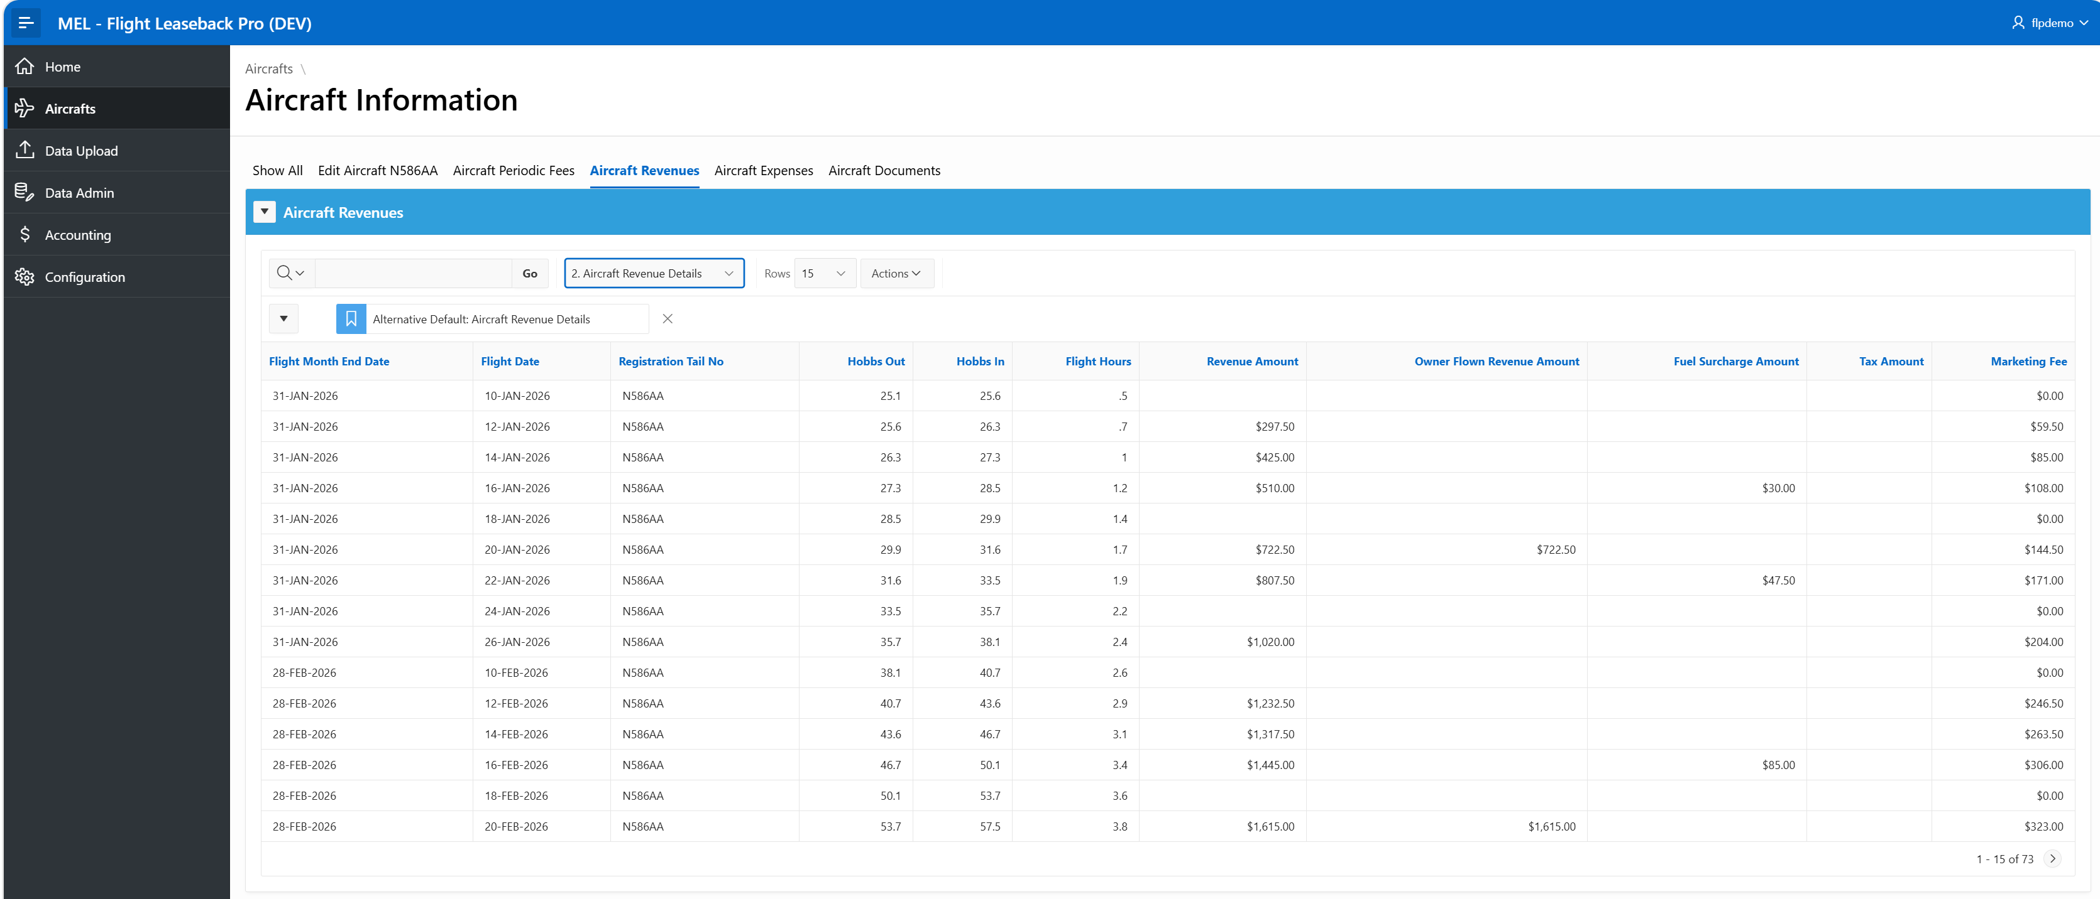
Flight Leaseback Pro - Aircraft Detail
Note: You can change primary report to the detail report, which displays each flight information and corresponding calculated number based on the logic. When data is uploaded, it removes the client's name for privacy reason.
Notes:
So there is no single solution….

Slide 13
Flight Leaseback Pro - Aircraft Detail
Logic to calculate the numbers:
Output Number | Sum of | When
Flight Hour | Hobbs Total
Non-Revenue Hours | Hobbs Total | Activity Type is like ‘Non-Revenue%’
Revenue Hours | Hobbs Total | Activity Type is not like ‘Non-Revenue%’
Revenue Amount | Hobbs Total * Rent | Activity Type is not like ‘Non-Revenue%’
Owner flown Hours | Hobbs Total | Activity Type is like ‘Owner Instruction%’
Owner flown Revenue Amount | Hobbs Total * Rent | Activity Type is like ‘Owner Instruction%’
Fuel Surcharge Hours | Hobbs Total | Activity Type is like ‘Instruction Flight%’ OR ‘Private Pilot Training%’
Fuel Surcharge Amount | Hobbs Total * Fuel Surcharge | Activity Type is like ‘Instruction Flight%’ OR ‘Private Pilot Training%’
Taxable Hours | Hobbs Total | Instructor Name is null
Taxable Amount | Hobbs Total * Rent * Sales Tax % | Instructor Name is null
Revenues to Calculate Marketing Fee | Hobbs Total * Rent | Activity Type is not like ‘Non-Revenue%’ (Activity Type is not like ‘Owner Instruction%’, when owner use is not included in the calculation)
Marketing Fee | Hobbs Total * Rent * Marketing Fee % | Activity Type is not like ‘Non-Revenue%’ (Activity Type is not like ‘Owner Instruction%’, when owner use is not included in the calculation)
Notes:
So there is no single solution….

Slide 14
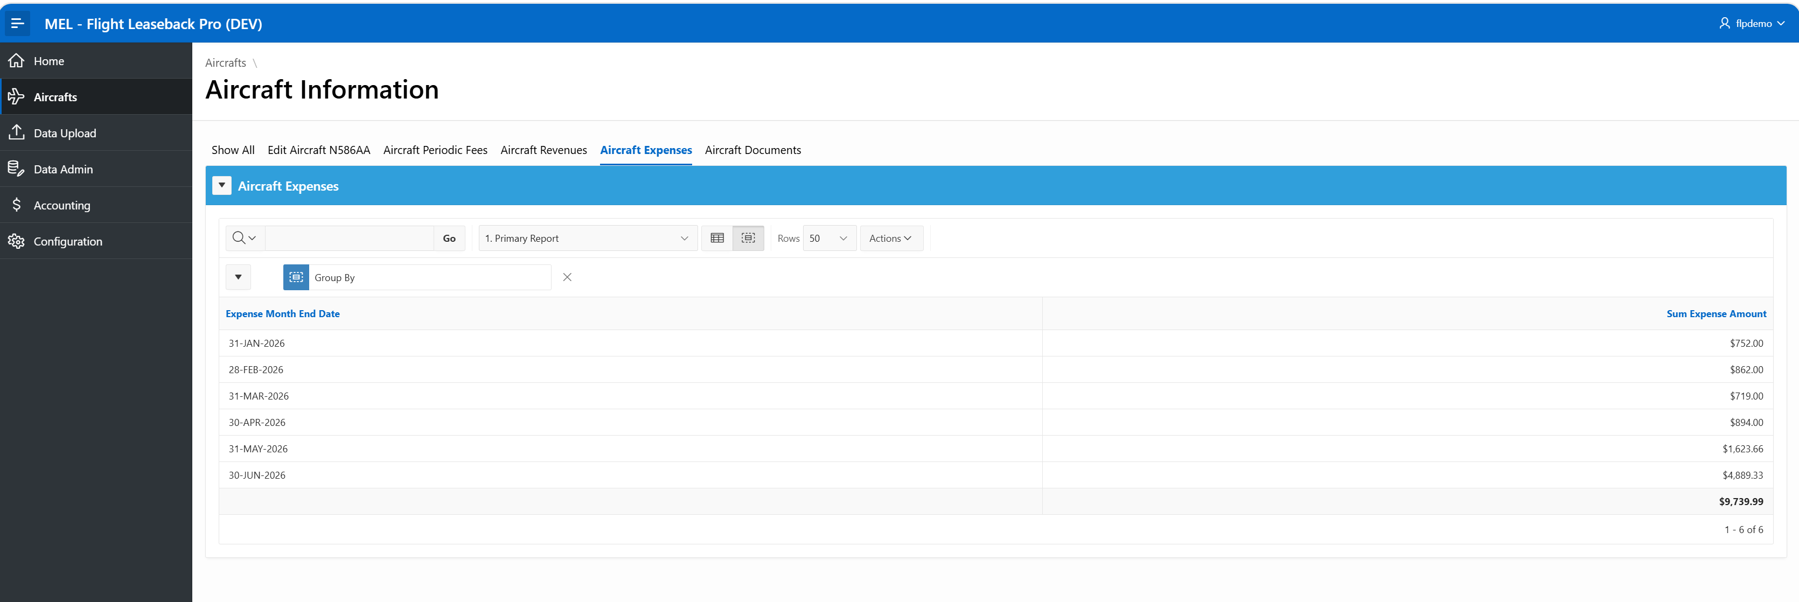
Flight Leaseback Pro - Aircraft Detail
Note: Aircraft Expenses Tab displays summary of expenses per month as a primary report. All such interactive reports can be customized and saved for future use by end user.
Notes:
So there is no single solution….

Slide 15
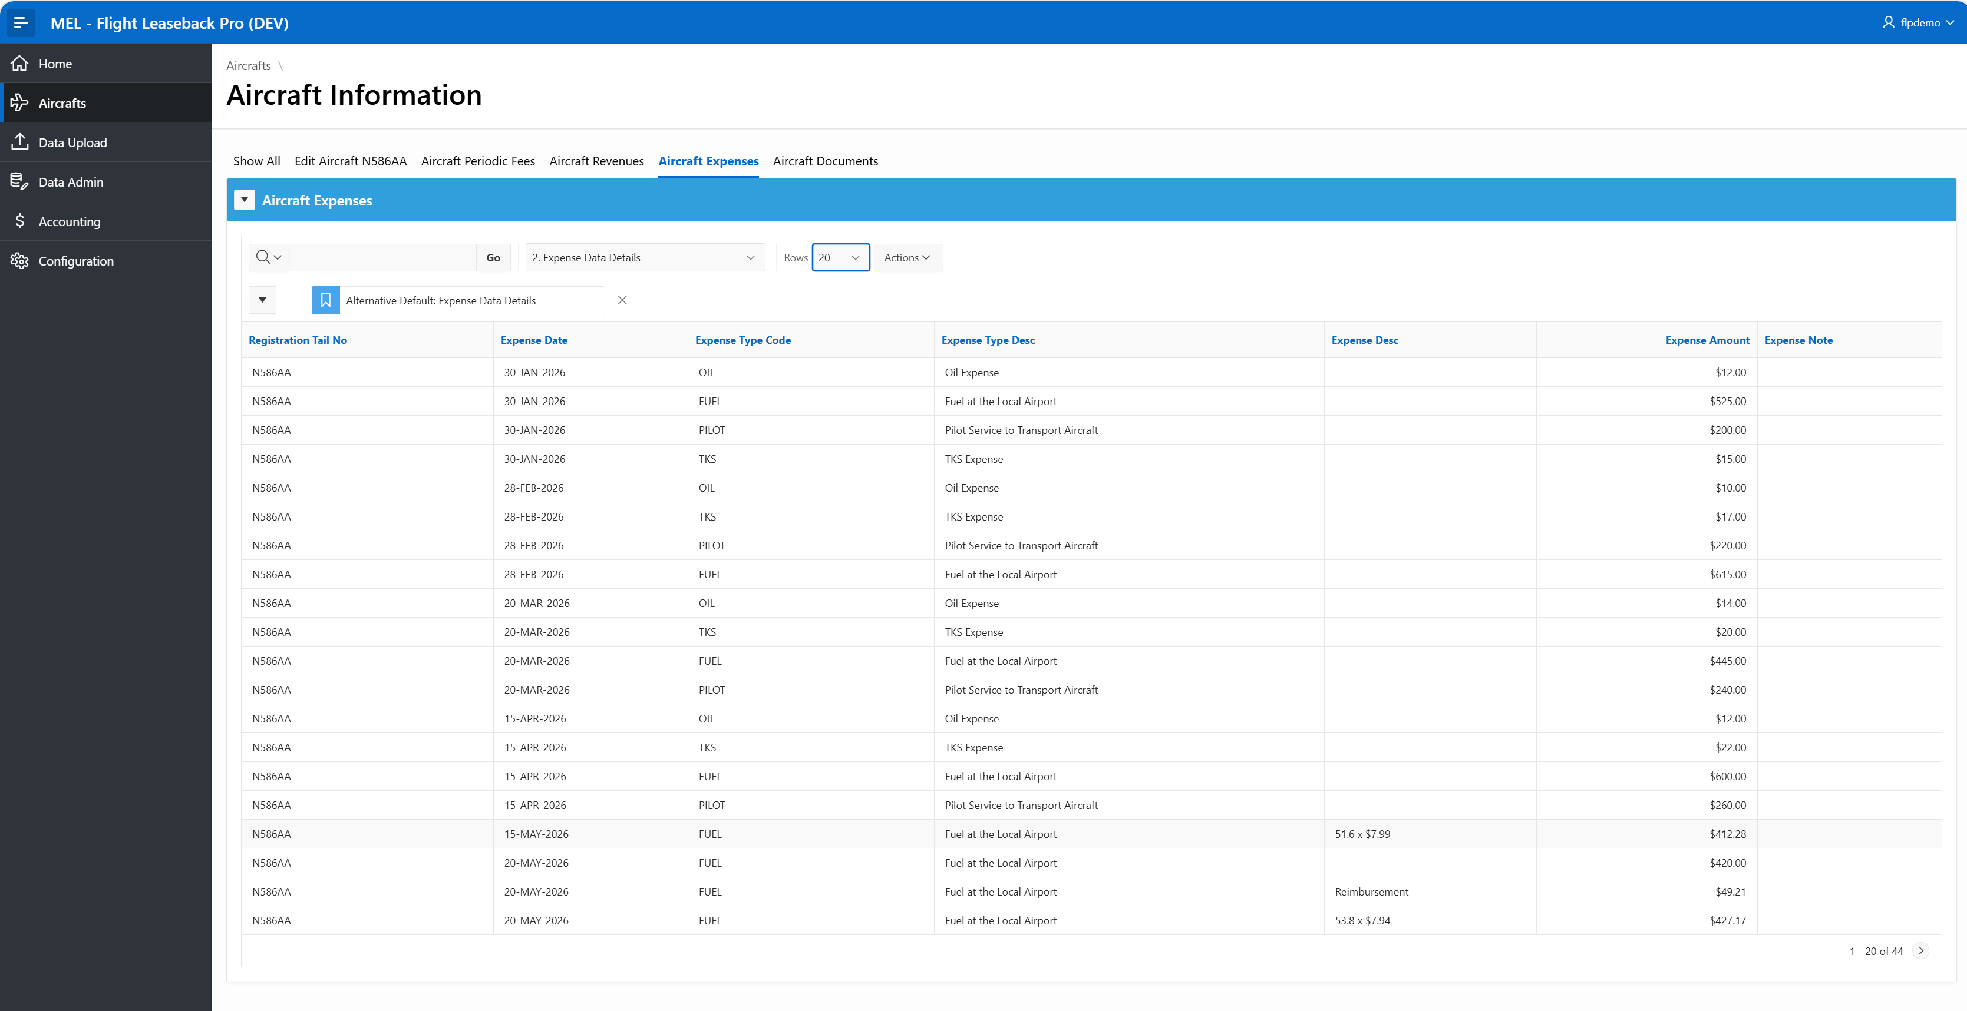
Flight Leaseback Pro - Aircraft Detail
Note: You can change primary report to the detail report, which displays each expense information.
Notes:
So there is no single solution….

Slide 16
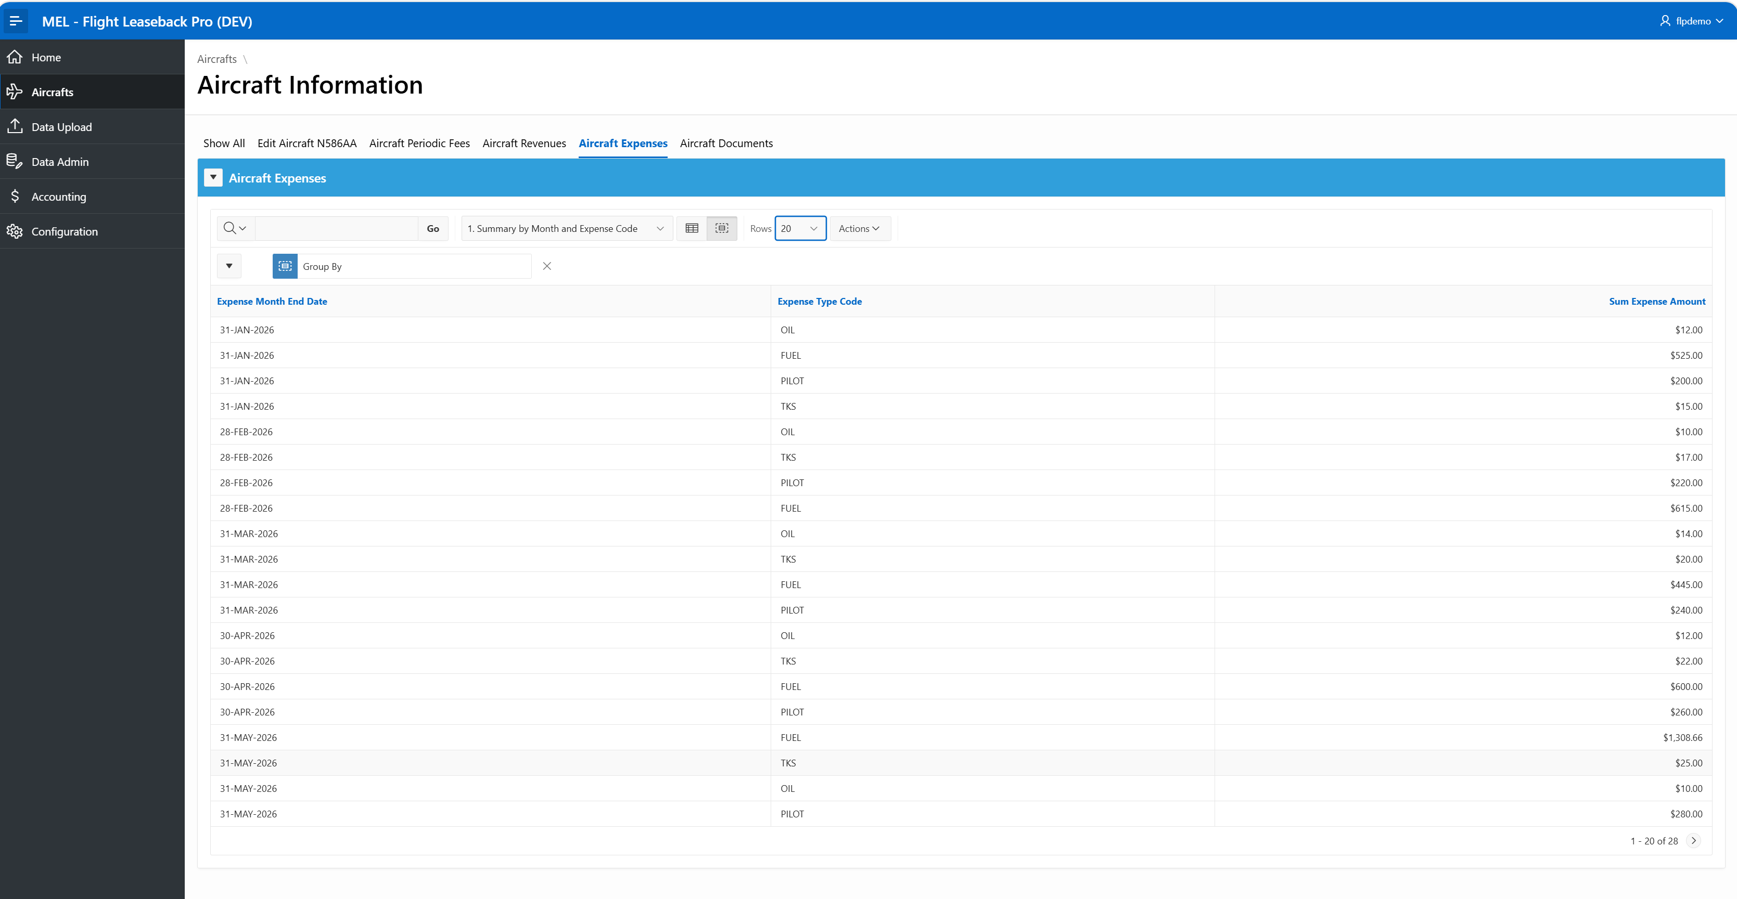
Flight Leaseback Pro - Aircraft Detail
Note: You can change to display summary by month and expense code.
Notes:
So there is no single solution….

Slide 17
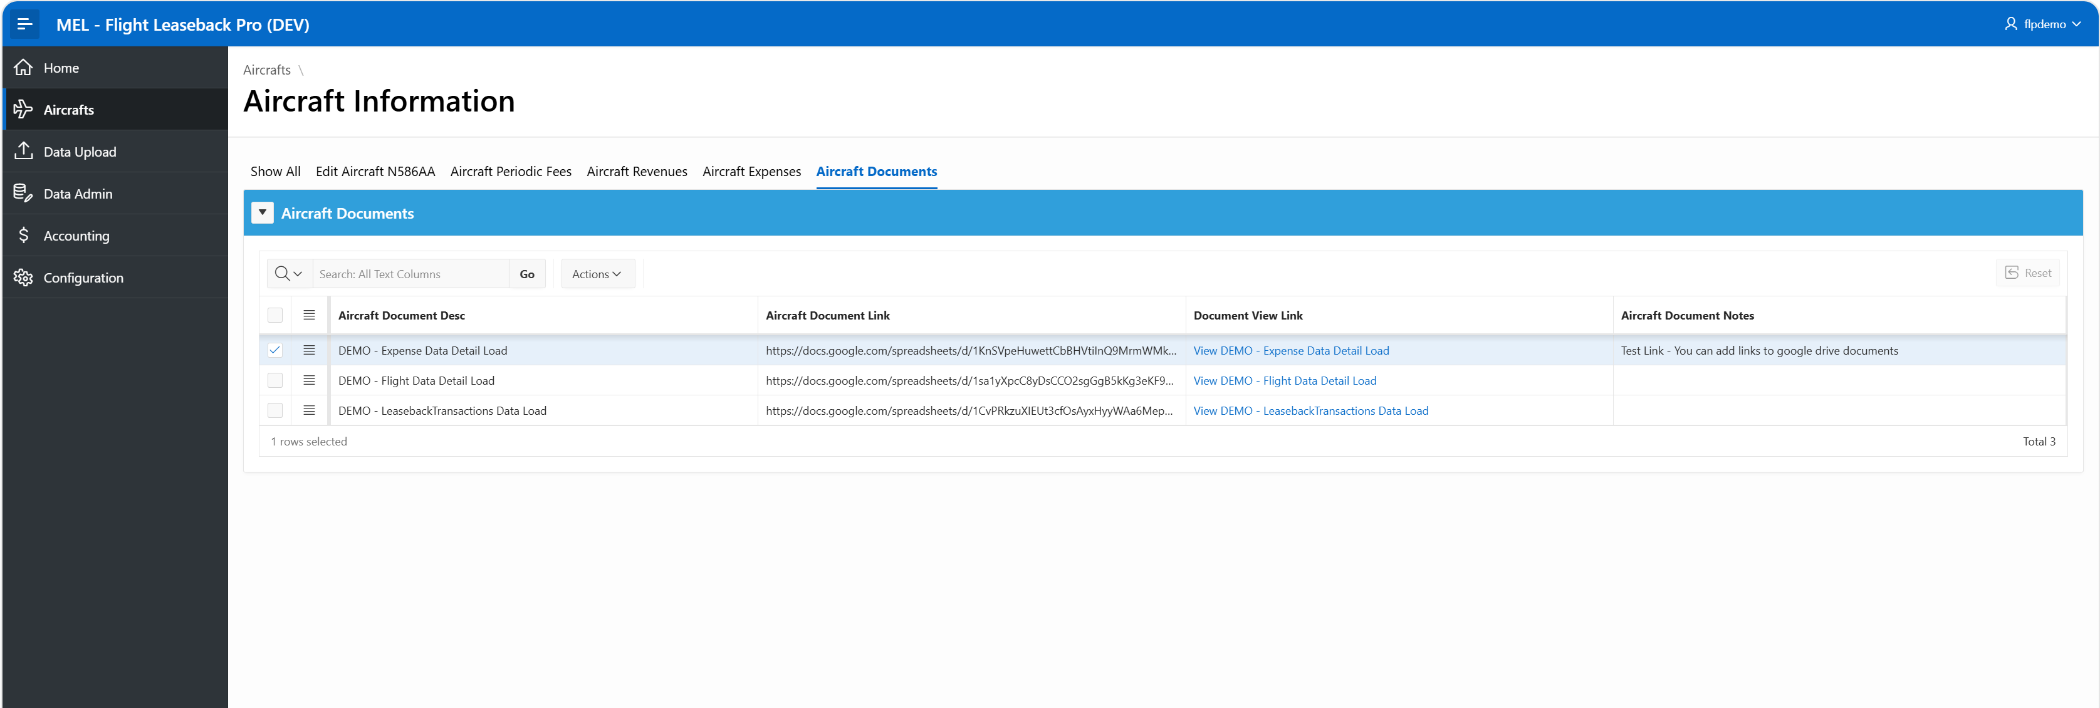
Flight Leaseback Pro - Aircraft Detail
Note: You can organize and maintain the aircraft related document by adding hyperlinks to the document, such as google drive document.
Notes:
So there is no single solution….

Slide 18
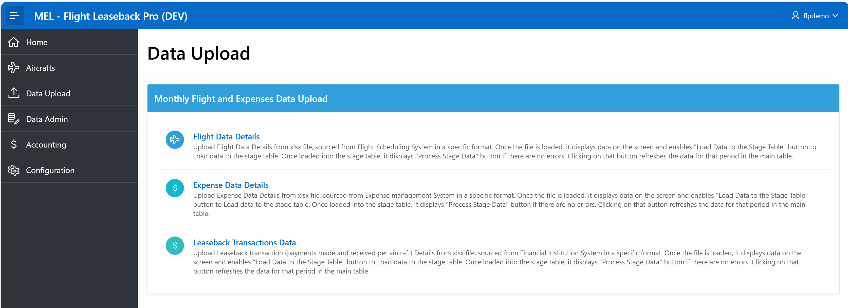
Flight Leaseback Pro – Data Upload
Note: You just need to upload three datasets (Flight Data, Expense Data and Leaseback Transactions) to the system using xlsx file in a specific format.
Notes:
So there is no single solution….

Slide 19
Flight Leaseback Pro – Data Upload
Note: You just need to upload three datasets (Flight Data, Expense Data and Leaseback Transactions) to the system using xlsx file in a specific format. Data upload is only available to who ever is granted such permissions.
Notes:
So there is no single solution….

Slide 20
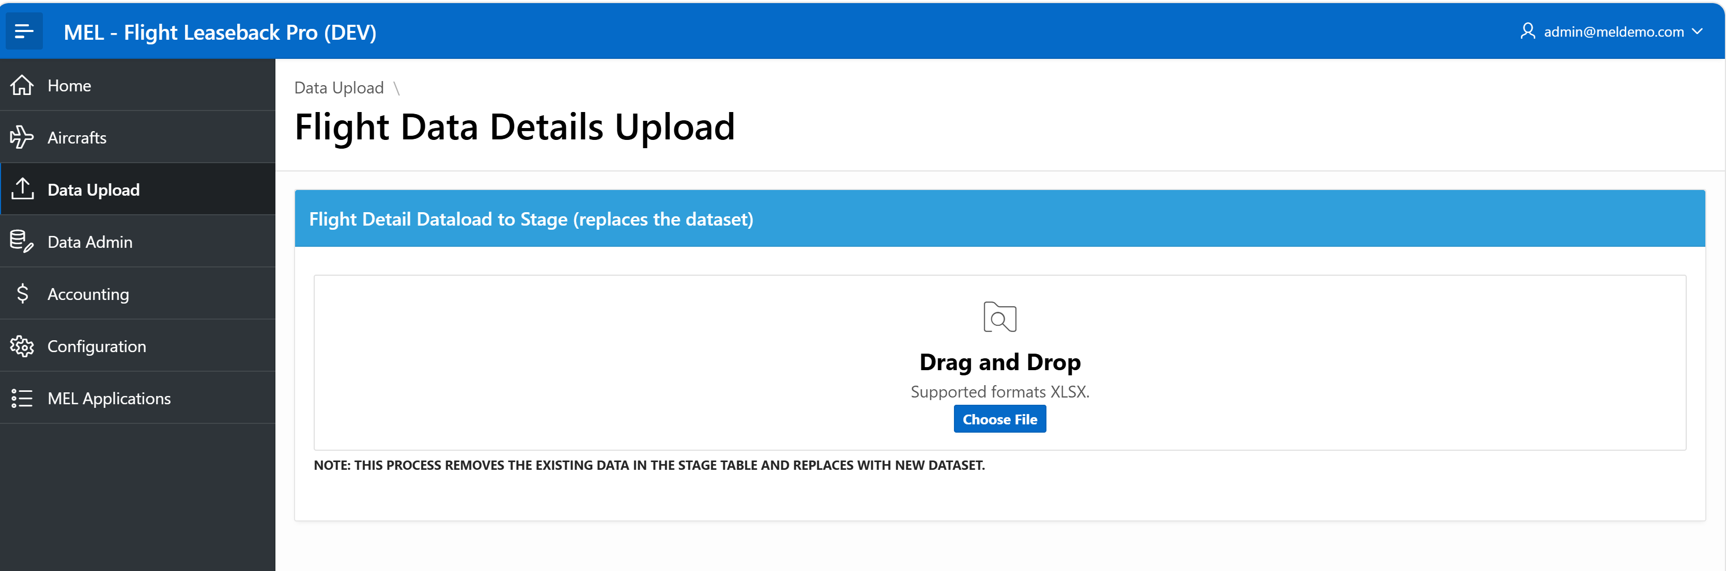
Flight Leaseback Pro – Data Upload
Note: You just need to drag and drop the datafile in xlsx specific format. If no errors, then it displays data on the screen.
Sample Datafile Templates:
Filght Data Details Template
Expenses Data File Template
Leaseback Transaction File Template
Notes:
So there is no single solution….

Slide 21
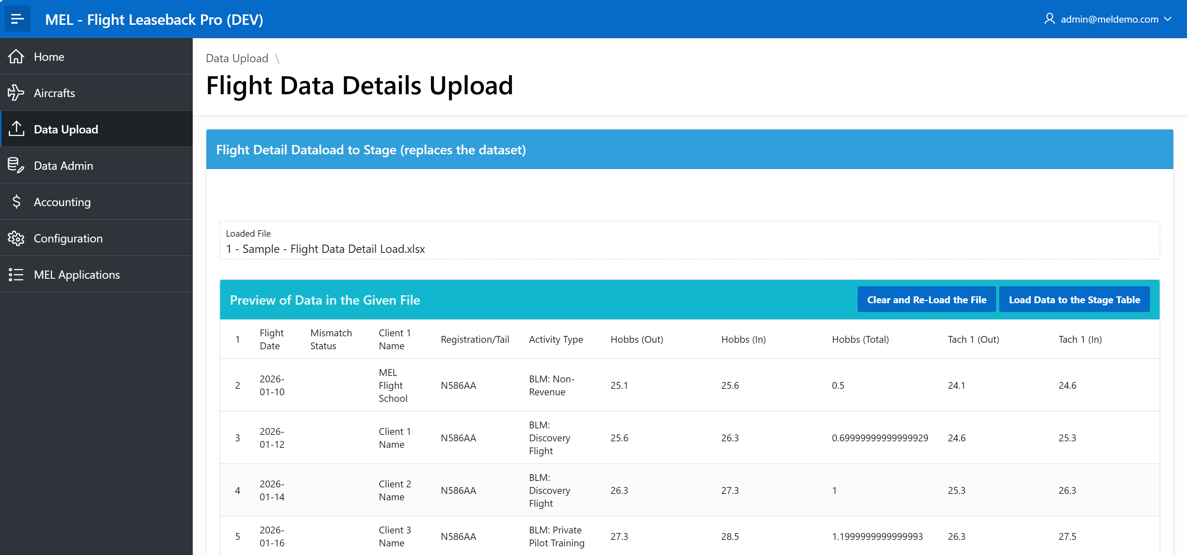
Flight Leaseback Pro – Data Upload
Note: Click on “Load data to the Stage Table.
Notes:
So there is no single solution….

Slide 22
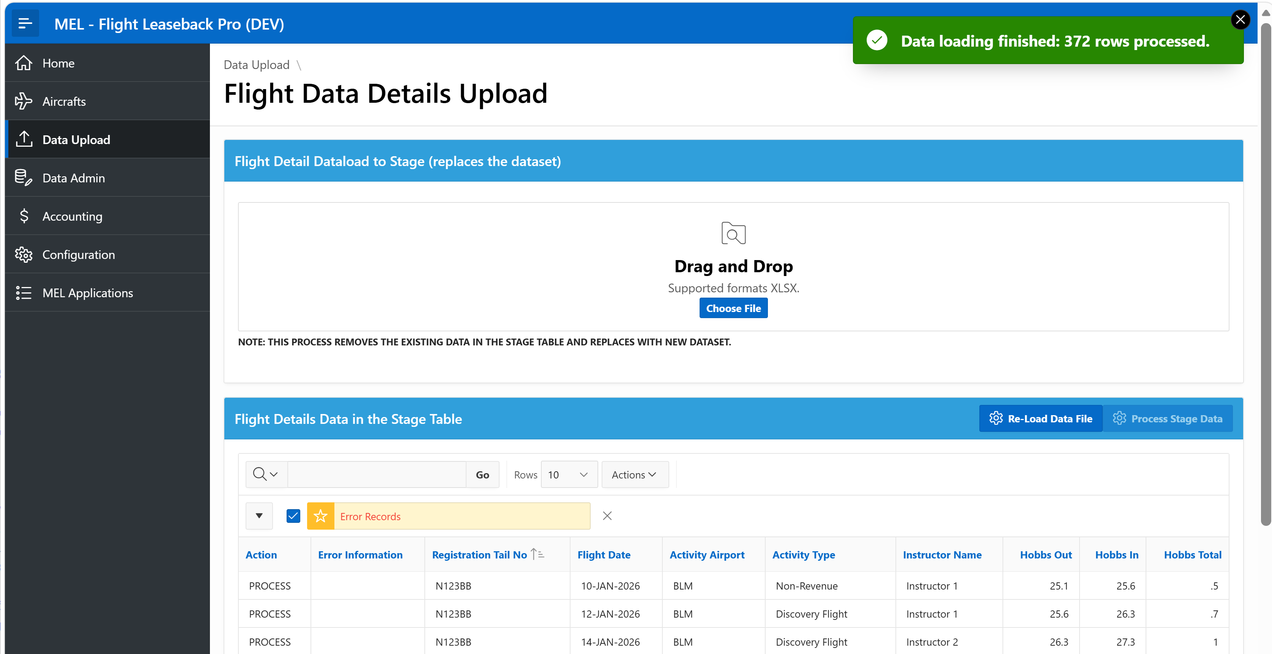
Flight Leaseback Pro – Data Upload
Note: Click on “Load data to the Stage Table”, loads data into the stage table and displays report. Each row is validated and indicates that it is ready to process or there is any error. It disables the “Process Stage Data” button , when there is any error.
Notes:
So there is no single solution….

Slide 23
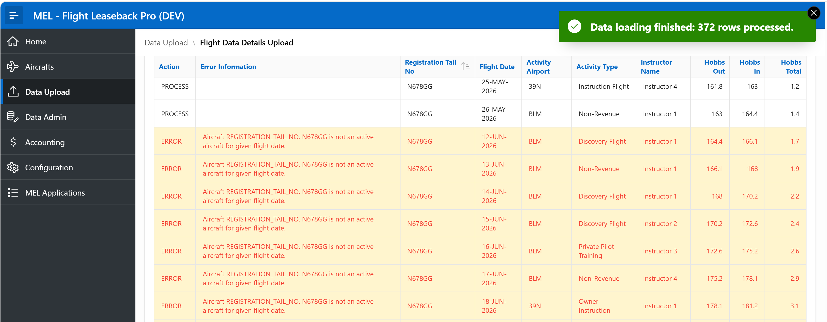
Flight Leaseback Pro – Data Upload
Note: Scroll thru the rows and find the issues and fix it in the datafile and re-upload to stage and then click on “Process Stage Data”, which will refresh/replace the data in the main table for same aircraft and same period. If you have maintained data manually via screen which were already loaded then be careful, those may be replaced as well.
Process checks for Hobbs & Tach gaps, valid Registration/Tail No. etc. Similar interface to upload Expenses and Leaseback Transaction data files.
Notes:
So there is no single solution….

Slide 24
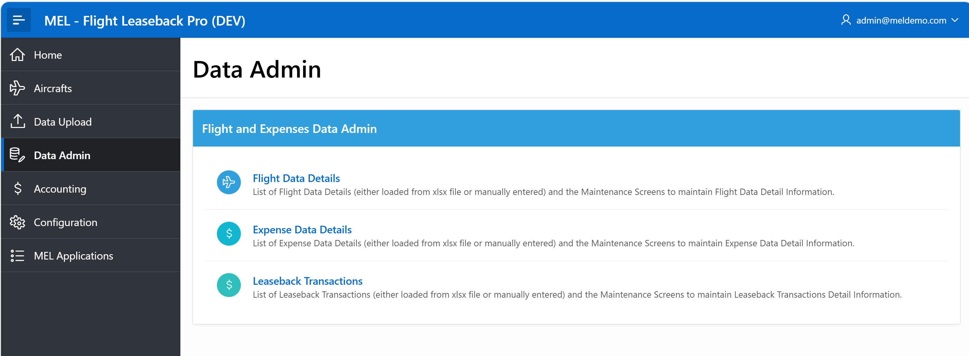
Flight Leaseback Pro – Data Admin
Note: Data Admin module allows you to maintain uploaded data thru screens. Also, it has reporting data in various formats, summary, etc. and downloaded if you have proper permissions.
Notes:
So there is no single solution….

Slide 25
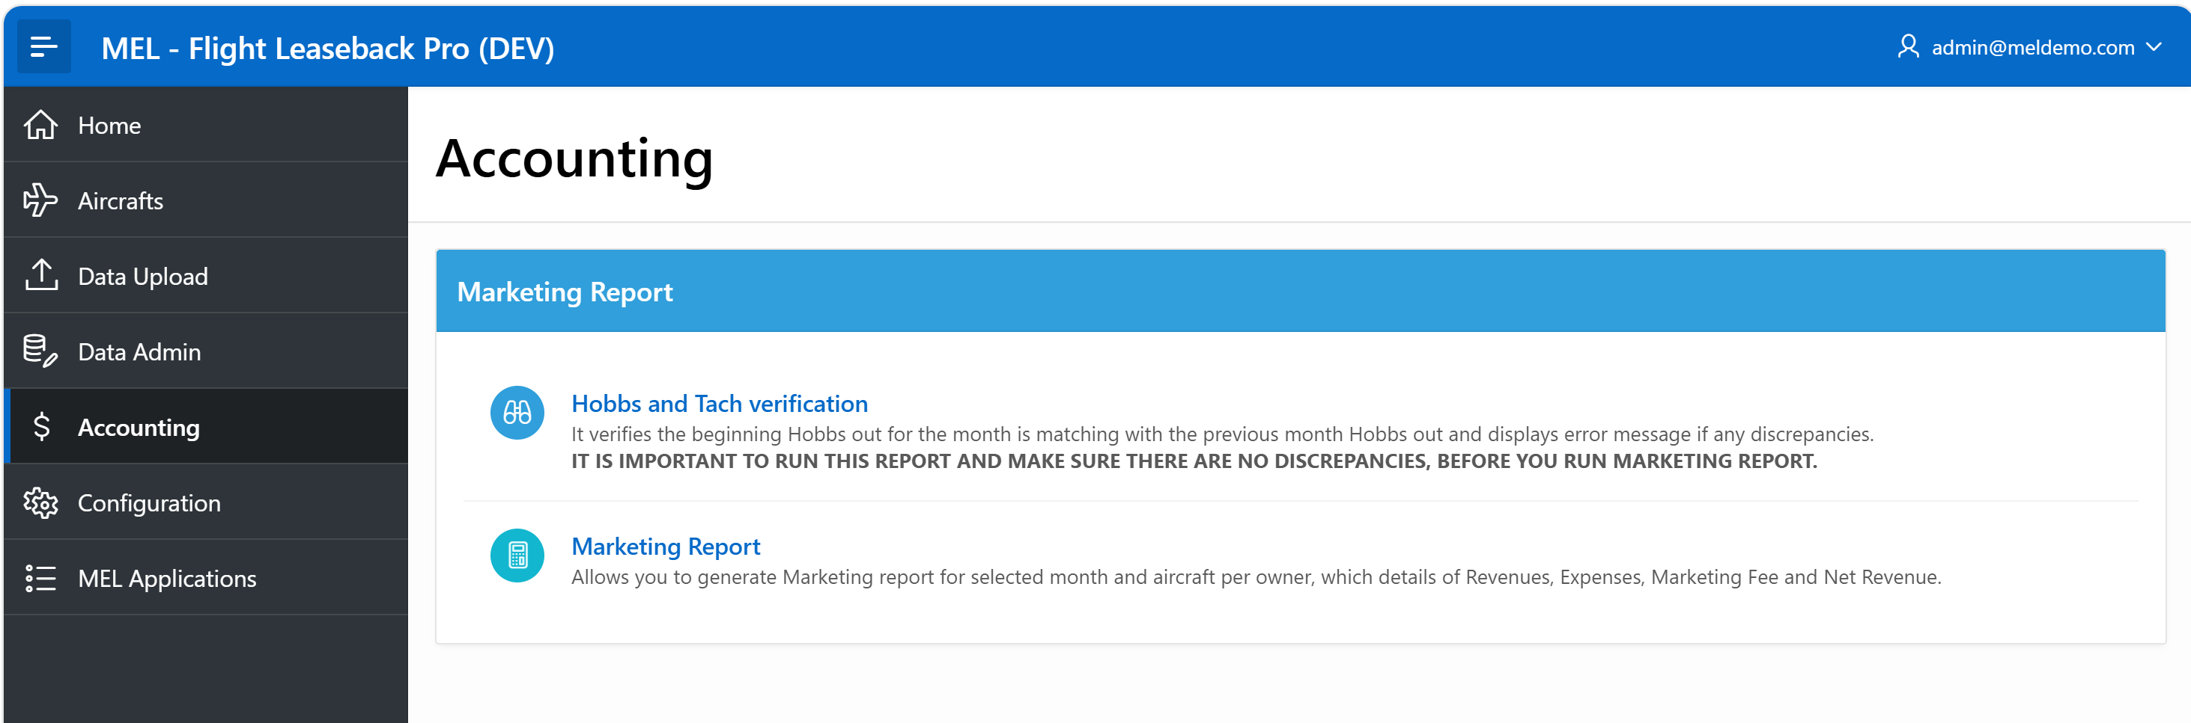
Flight Leaseback Pro – Accounting
Note: Accounting module where you can verify data integrity across all different periods. It check Hobbs and Tach start numbers with prior month end numbers, before you run marketing report and generate emails. If there are any discrepancies it will be displayed and you might want to fix those before running and distributing the reports.
Notes:
So there is no single solution….

Slide 26
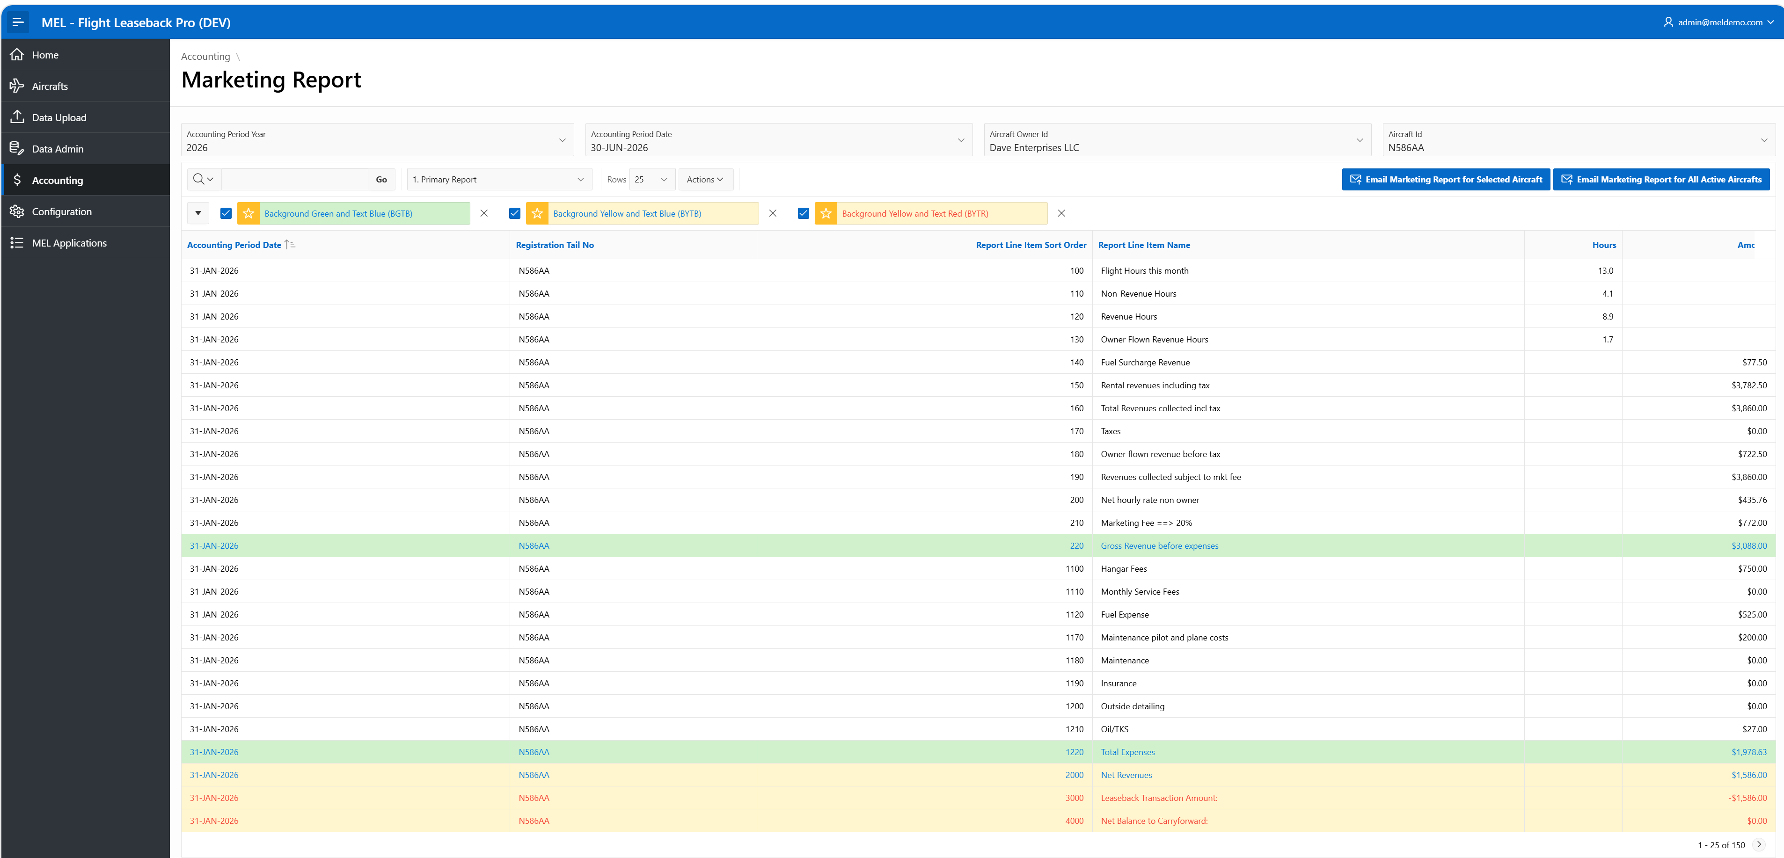
Flight Leaseback Pro – Accounting
Note: Marketing primary report is generated for selected Accounting period and Aircraft for that month only.
Notes:
So there is no single solution….

Slide 27
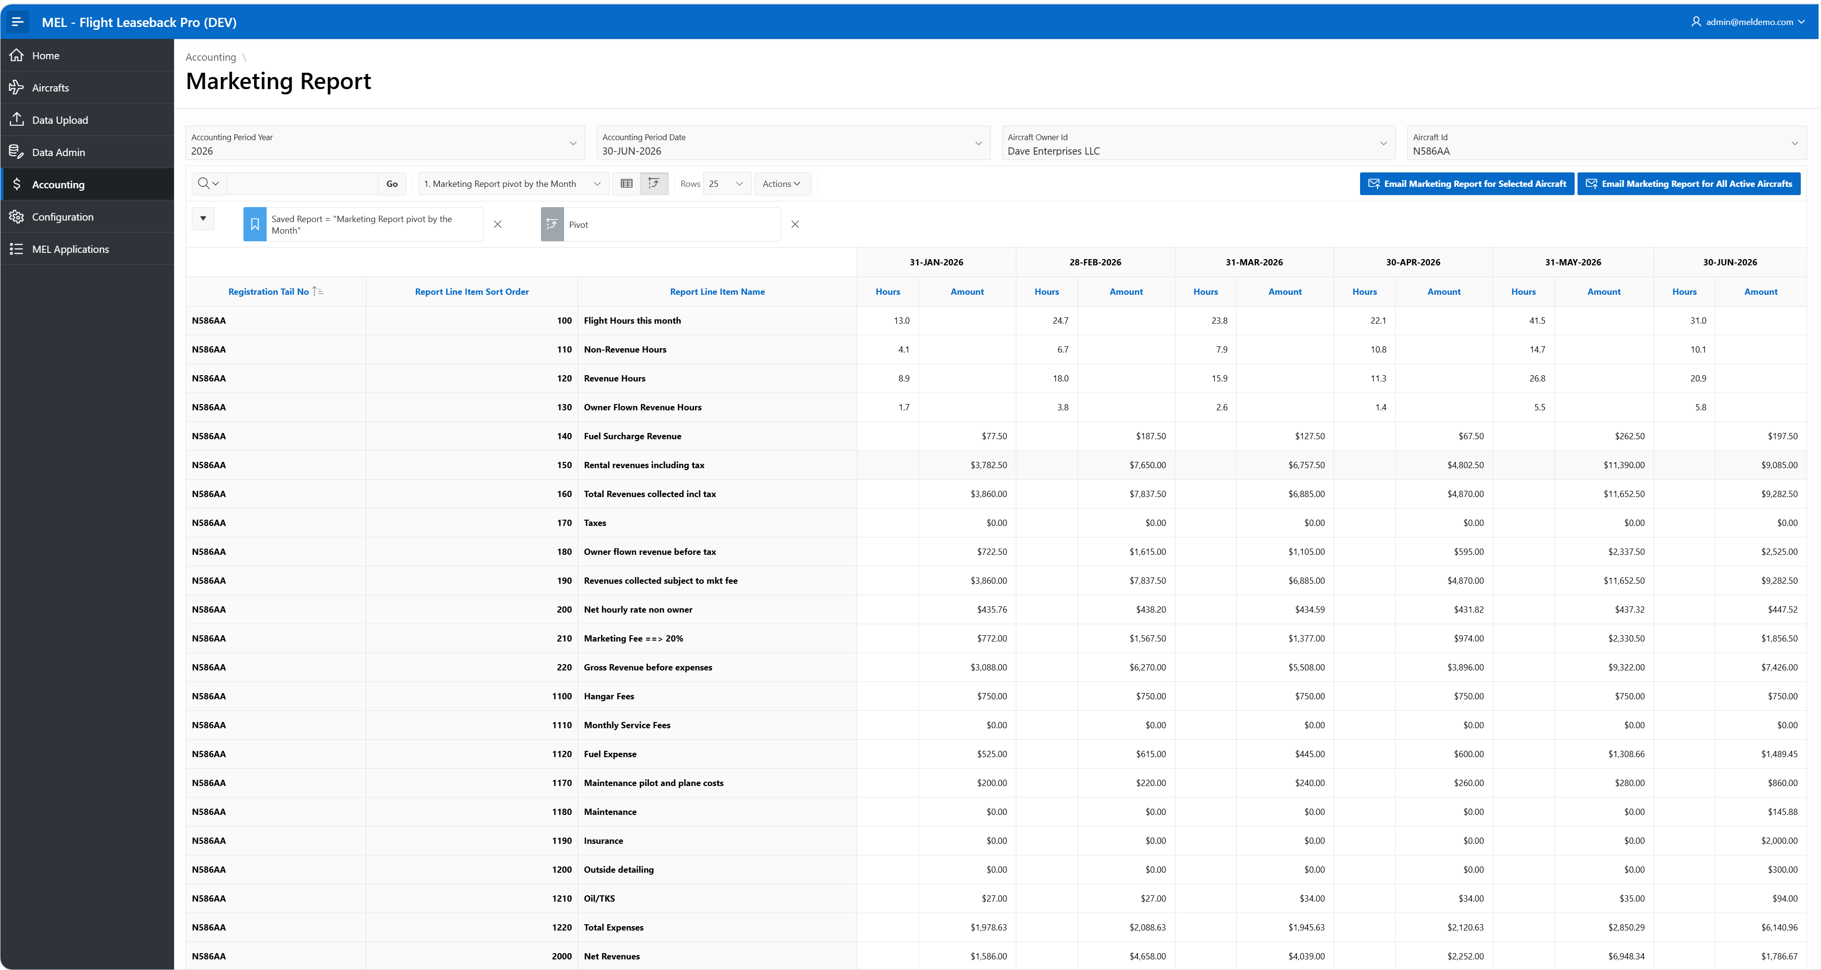
Flight Leaseback Pro – Accounting
Note: Selecting “Marketing Report pivot by the Month” generates a matrix report from beginning of the year to selected accounting period.
Notes:
So there is no single solution….

Slide 28
Flight Leaseback Pro – Accounting
Note: Clicking on these buttons generates marketing report and sends it in an email to the user who is logged in. First button is for only selected aircraft, and the second button is to generate email with report for each active aircraft for the selected period.
Notes:
So there is no single solution….

Slide 29
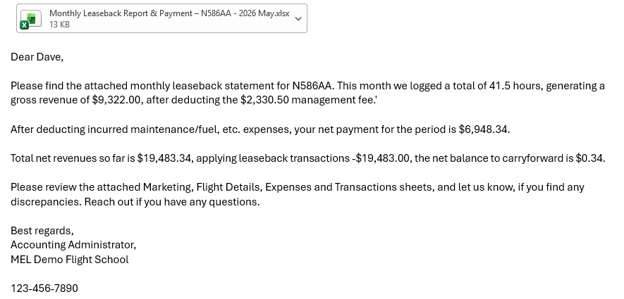
Flight Leaseback Pro – Accounting
Note: Here is a sample email, with attached report.
Notes:
So there is no single solution….

Slide 30
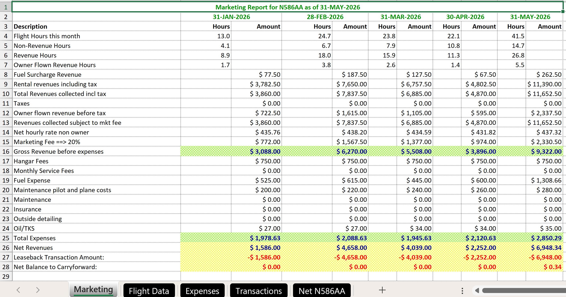
Flight Leaseback Pro – Accounting
Note: Here is a sample Marketing Sheet.
Notes:
So there is no single solution….

Slide 31
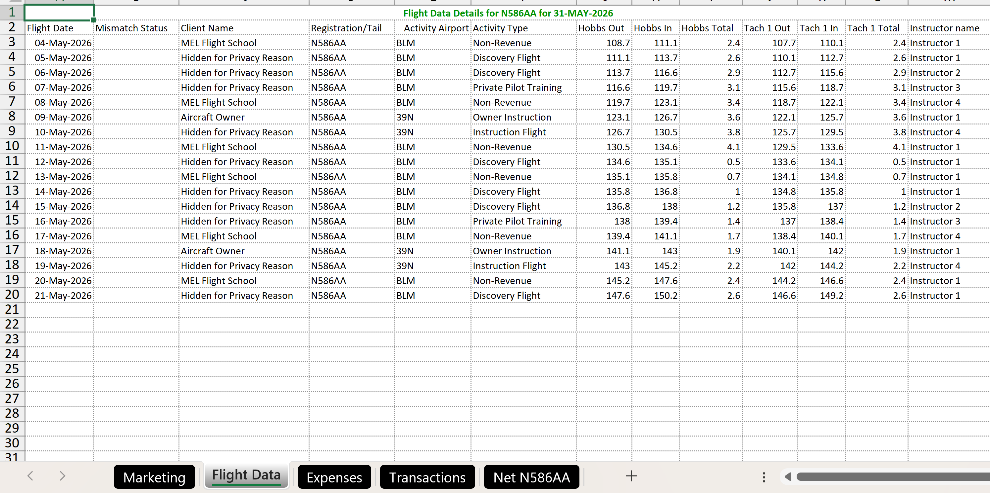
Flight Leaseback Pro – Accounting
Note: Here is a sample Flight Data Sheet.
Notes:
So there is no single solution….

Slide 32
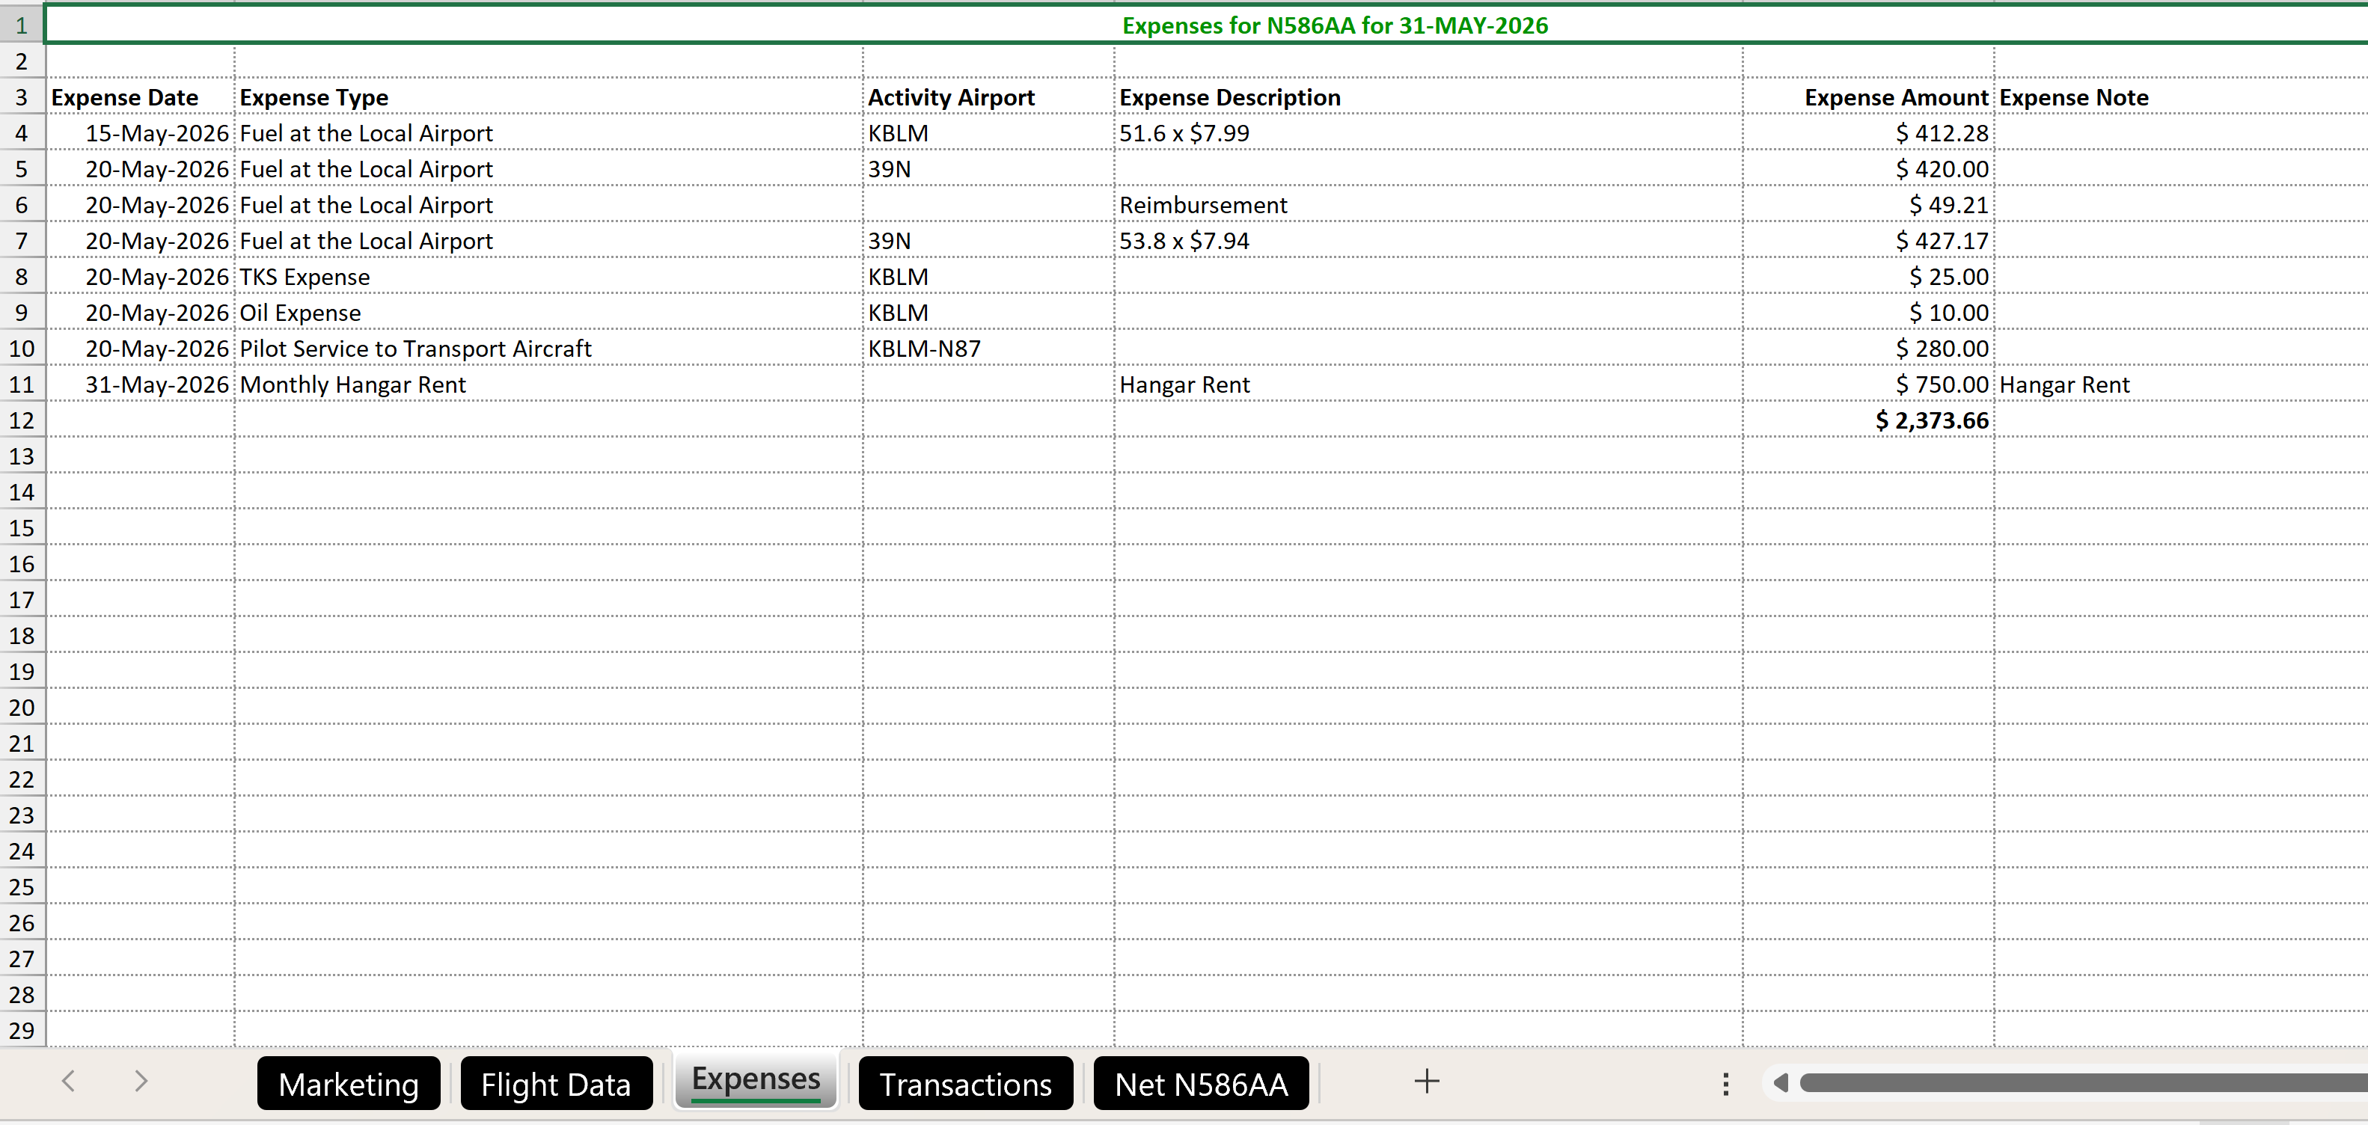
Flight Leaseback Pro – Accounting
Note: Here is a sample Expenses Sheet.
Notes:
So there is no single solution….

Slide 33
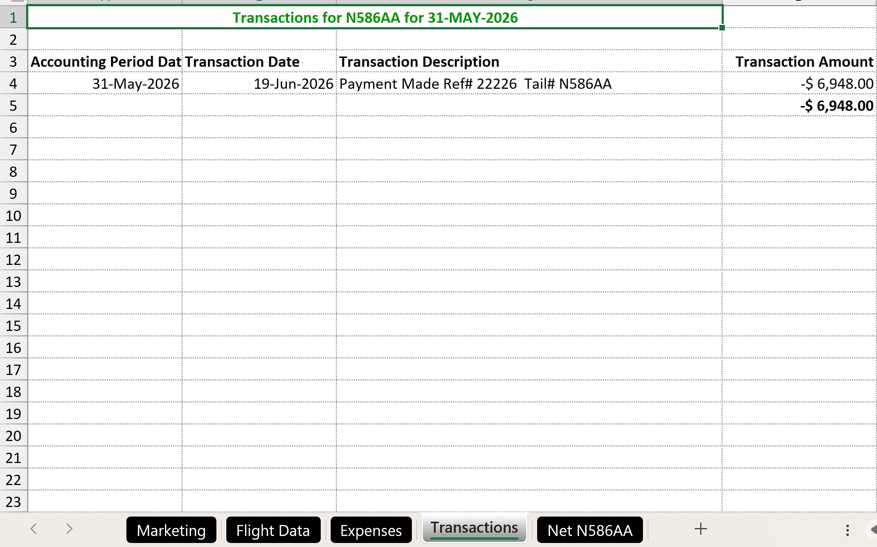
Flight Leaseback Pro – Accounting
Note: Here is a sample Leaseback Transactions Sheet. Lists transaction for the accounting period, transaction date may not be in the same period.
Notes:
So there is no single solution….

Slide 34
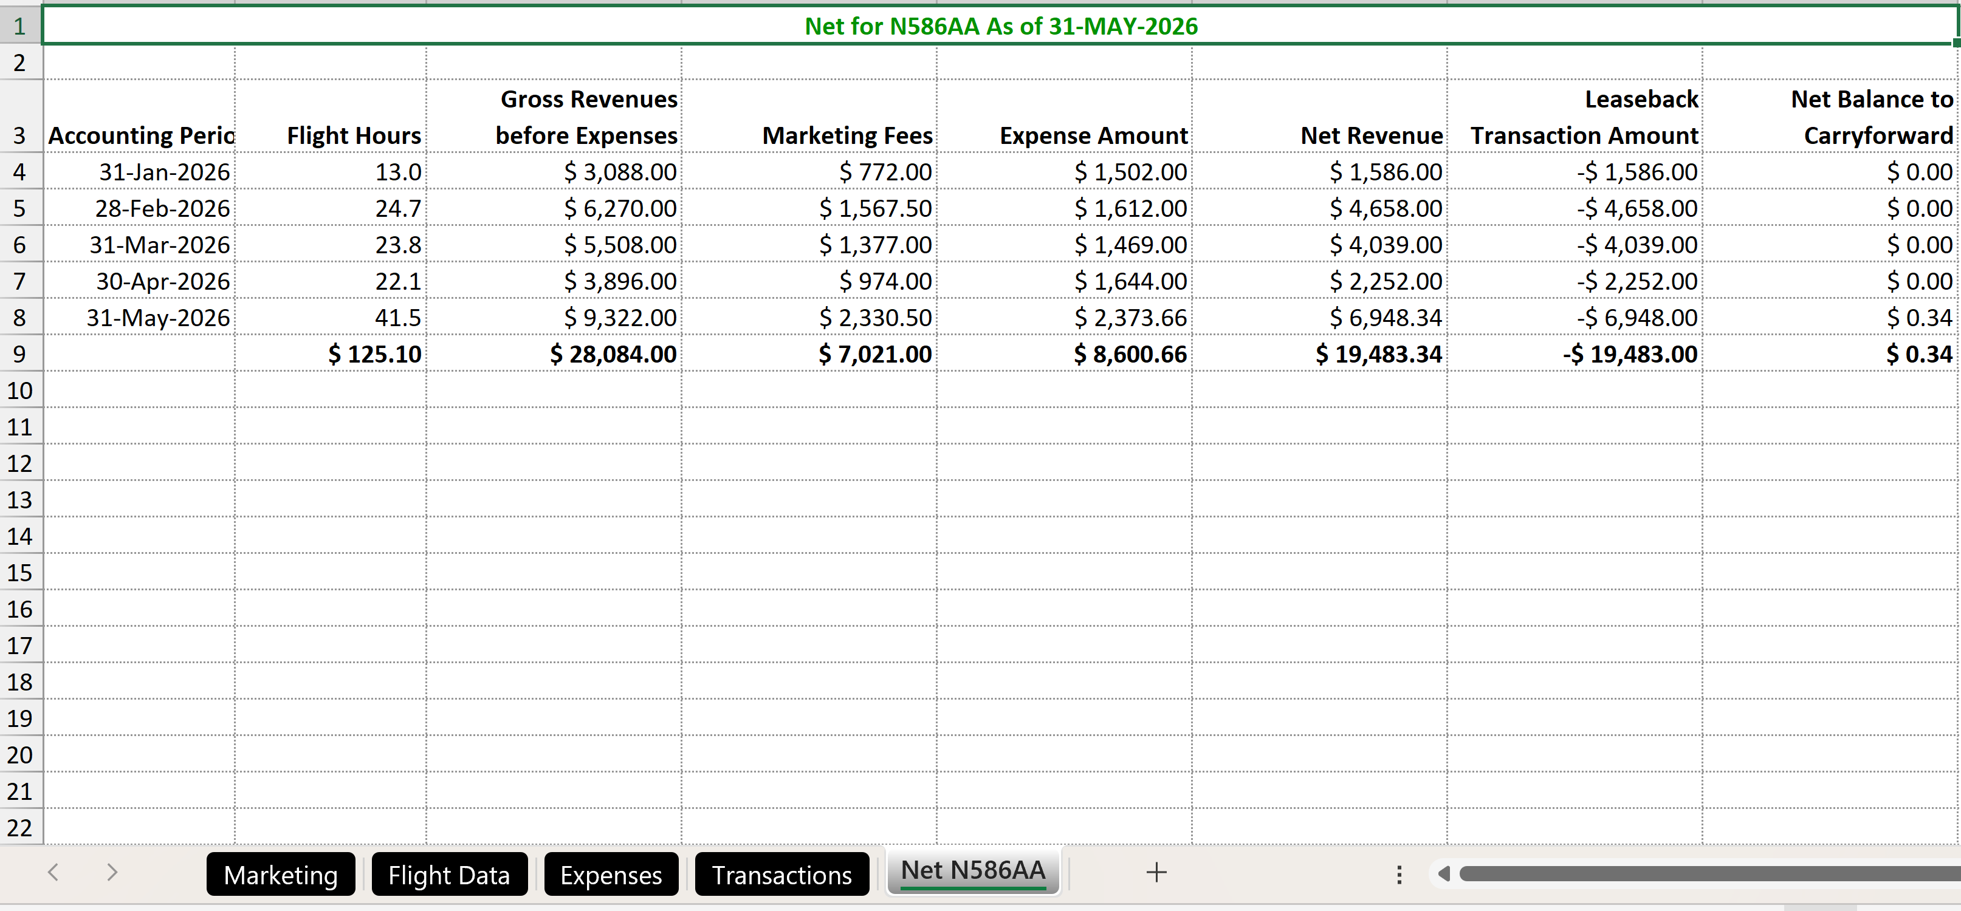
Flight Leaseback Pro – Accounting
Note: Here is a sample Net Sheet, which is a summary per month, from beginning of leaseback. Shows the details every month to Lessor and final balance as end of the accounting period.
Notes:
So there is no single solution….

Slide 35
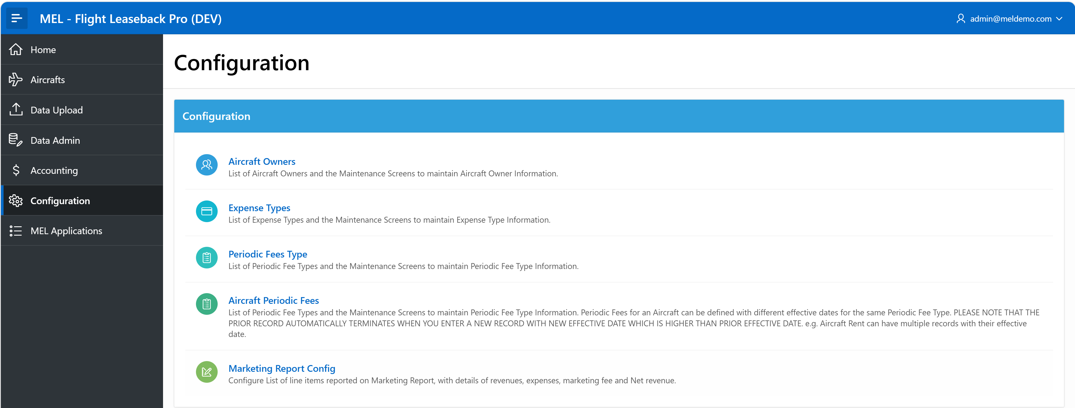
Flight Leaseback Pro – Accounting
Note: Configuration option is to configure and maintain information about Aircraft Owners, Expense Types, Periodic Fee Types, Aircraft’s specific fees for applicable periodic fees. Also, you can customize marketing report.
Notes:
So there is no single solution….

Slide 36
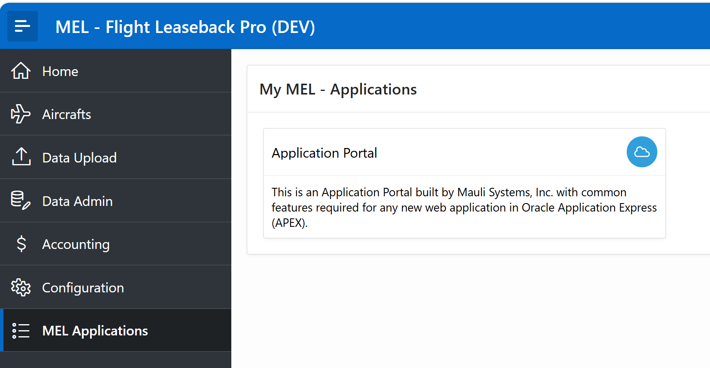
Flight Leaseback Pro – Accounting
Note: Access to Application Portal is only available to company Admins, where they can maintain users list and grant/revoke permissions to different modules in “Flight Leaseback Pro” system as they wish. There are some application monitoring report that admin can run to monitor.
Notes:
So there is no single solution….

Slide 37
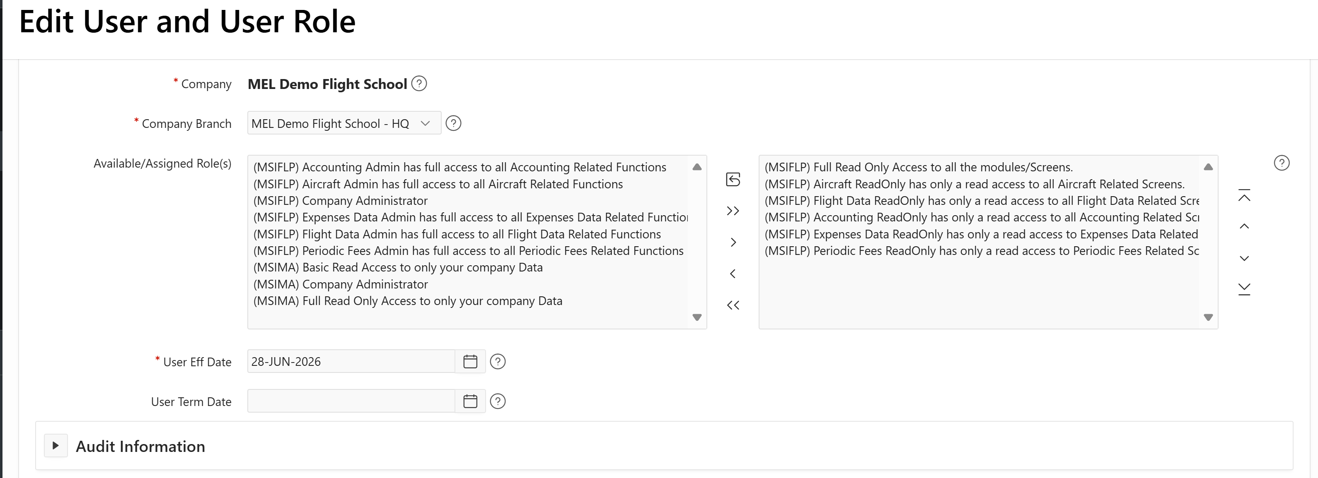
Flight Leaseback Pro – Accounting
Note: There are different roles for application and can be assigned or removed to a user. User can also be terminated by updating termination date. Each module has ReadOnly and Admin roles. Admin role has full permission to specific module.
Notes:
So there is no single solution….

Slide 38
Summary
Saves hours of manual work every month.
Reduces administrative overhead.
Keeps every leaseback organized and compliant.
Improves visibility with real-time reporting.
Scales your business without adding administrative staff.
Replaces spreadsheets with a purpose-built platform.
Notes:
We provide all these solutions.

Slide 39
Summary
We offer FREE trial.
Send us email to request demo.
For more information, please contact
Info@mauli.com.

Slide 40
Q
&
A

Slide 41
Thank You!
send me questions & comments directly:
  Kashyap Shukla, Mauli Systems, Inc.
  Phone: 203-788-7722
  Email: Kashyap_shukla@mauli.com

